Slide 1

OPTIMUM SELECTION OF STORAGE BATTERY FOR ELECTRIC VEHICLES USING MULTI CRITERIA DECISION MAKING TECHNIQUES
DEPARTMENT OF MECHANICAL ENGINEERING
LBS COLLEGE OF ENGINEERING
KASARAGOD
Group No: B-6
Presented by:
Anandu A
Aswanth Lal
Nihal Rashid
Muhammed Sinan Iqbal
Under the guidance of
Dr. Anil Kumar B.C

Slide 2
OVERVIEW
Introduction
Objective
Literature Survey
Methodology
Result and Discussion
Conclusion
References

Slide 3
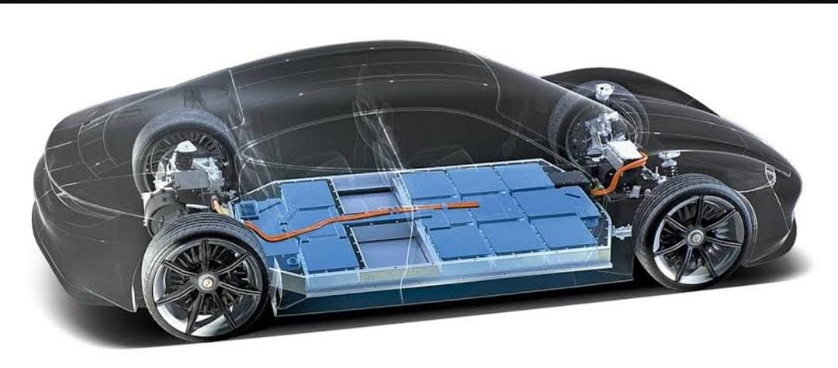
INTRODUCTION
ELECTRIC VEHICLES (EV)
Uses electric motors for propulsion.
Important parts:
Controller
Battery
Electric motor
Types of EV:
Battery EV (BEV)
Hybrid EV (HEV)
Plug-in HEV (PHEV)

Slide 4
Merits of EV
No Emission
Energy source is renewable.
Lower maintenance.
High efficiency.
Demerits of EV
Higher purchase cost.
Low speed and range.
Higher maintenance cost.
Slow charging.

Slide 5
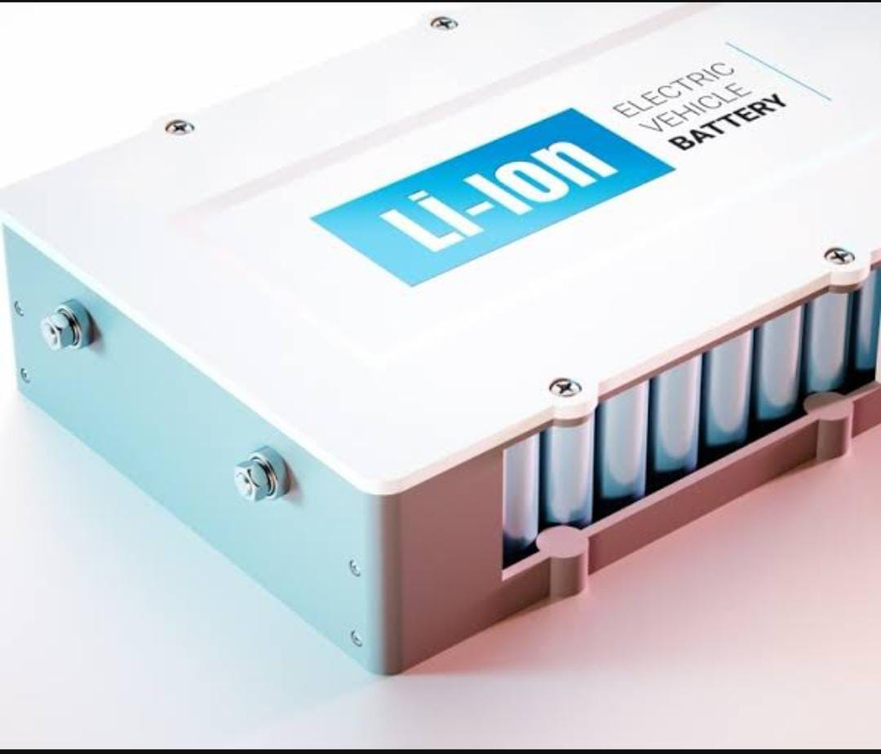
Battery Alternatives
Lithium Ion Phosphate (LFP)
Nickel Metal Hydride (NiMH)
Lithium Titanate Oxide (LTO)
Sodium Metal Halide (ZEBRA)
Lithium Manganese Oxide (LMO)
Lithium Cobalt Oxide (LCO)
Nickel Cadmium (Ni-Cd)

Slide 6
Battery Parameters
Nominal Voltage (V)
Specific Energy (Wh/kg)
Energy Density (Wh/L)
Specific Power (W/kg)
Energy Efficiency (%)
Life Cycle
Working Temperature (˚C)
Production Cost

Slide 7
MCDM Techniques
Technique for order preference by similarity to ideal solution (TOPSIS)
Evaluation based on distance from average solution ( EDAS )
Multi Objective Optimization in the basis of ratio analysis (MOORA)
Weightage
Analytical hierarchy process ( AHP )
Criteria importance through intercriteria correlation (CRITIC)
ENTROPY

Slide 8
OBJECTIVE
To select the best battery storage for electric vehicles from alternatives using multi criteria decision making techniques.

Slide 9
LITERATURE SURVEY
EV Batteries.
SL.NO | AUTHOR | TITLE OF PAPER | JOURNAL | INFERENCE
1 | Arun et al. (2022) | Review on Li-Ion Battery vs Nickel Metal Hydride Battery in EV. | Advances in Materials Science and Engineering, 2022 | Energy, Voltage comparisons. High discharge rate for NiMH. Low cost for NiMH. No maintenance for Li-Ion, but low maintenance required for NiMH.
2 | Maheshwari et al. (2022) | Modelling and State of Charge Estimation of Li-Ion Battery for Electric Vehicle. | In Power Electronics and High Voltage in Smart Grid (pp. 139-151). Springer, 2022 | Necessitates an accurate state of charge (SOC) estimation technique to control charging and discharging. High power to weight ratio and outstanding high temperature performance. Higher energy density.
3 | Ramkumar et al. (2022) | Review on Li-Ion Battery with Battery Management System in Electrical Vehicle. | Advances in Materials Science and Engineering, 2022. | BEV, HEV and PHEV type of electric vehicles. Electronic components for monitoring EV battery’s. Minimum operating expenses for EV since they have fewer moving components.

Slide 10
EV Batteries Contd.
SL.NO | AUTHOR | TITLE OF PAPER | JOURNAL | INFERENCE
4 | T V Chian et al. (2019) | A Review on recent progress on batteries for EV’s | International Journal of Applied Engineering Research | The development and revolution of battery technology from old centuries to latest battery technology have been reviewed in the paper.
5 | Norio et al. (2013) | High-power and long-life lithium-ion batteries using lithium titanium oxide anode for automotive and stationary power applications | Journal of Power Sources, Volume 244, 15 December 2013 | Cell performance and electrochemical characteristics of LTO/LMO system and LTO/NCM system were investigated for automotive and stationary applications

Slide 11
MCDM Techniques
SL.NO | AUTHOR | TITLE OF PAPER | JOURNAL | INFERENCE
1 | Anilkumar et al. (2021) | Optimum selection of phase change material for solar box cooker integrated with thermal energy storage unit using multi-criteria decision-making technique | Journal of Energy Storage, 2021 | AHP, ENTROPY, CRITIC method for criteria weightage. TOPSIS, EDAS, MOORA for selection of alternatives based on criteria weightage.
2 | Lee et al. (2018) | Comparative analysis of MCDM methods for ranking renewable energy sources in Taiwan | Renewable and Sustainable Energy Reviews, 2018 | WSN ,TOPSIS,VIKOR,ELECTRE MCDM technique analysis.
3 | Emovon et al. (2020) | Application of MCDM method in material selection for optimal design. | Results in Materials, 7, 100115, 2020 | Cost criterion is most used, best results from hybrid MCDM methods MAUA, WSM, WPM methods
4 | Kumar et al. (2017) | A review of multi criteria decision making (MCDM) towards sustainable renewable energy development. | Renewable and Sustainable Energy Reviews, 2017 | Finding optimum results in complex scenarios. Flexibility in decision making. Most suitable method for solving issues related to energy.

Slide 12
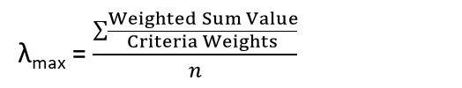
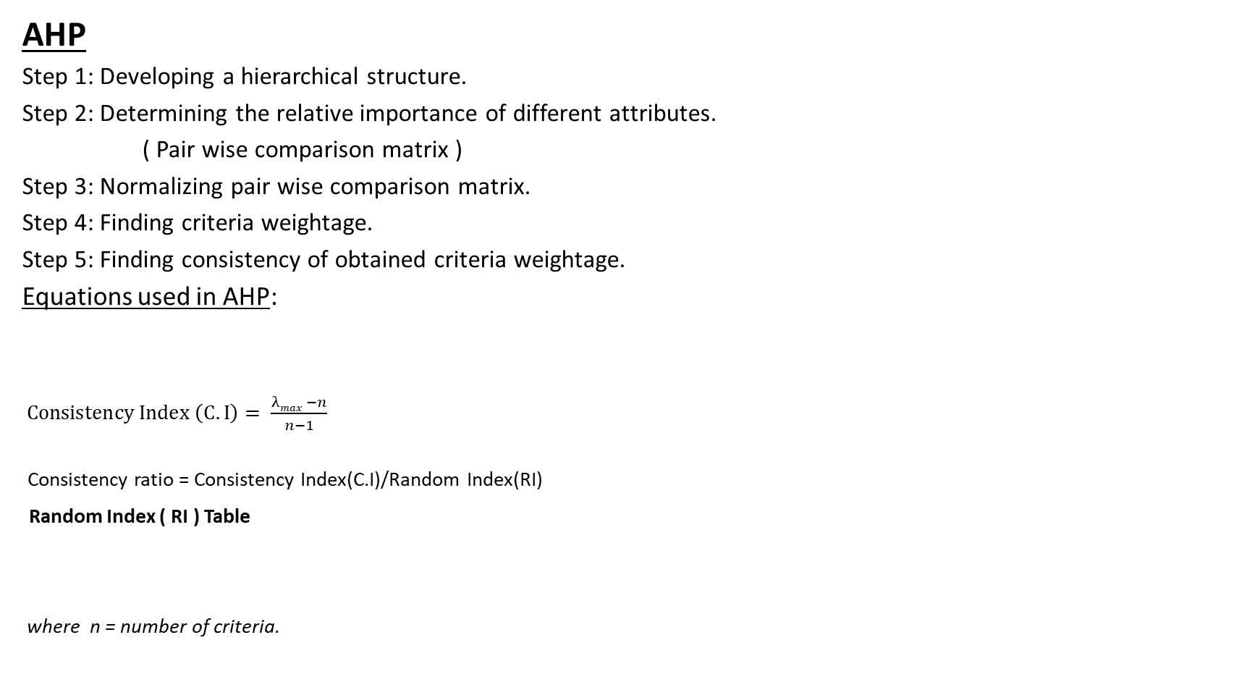
METHODOLOGY
AHP
Step 1: Developing a hierarchical structure.
Step 2: Determining the relative importance of different attributes.
( Pair wise comparison matrix )
Step 3: Normalizing pair wise comparison matrix.
Step 4: Finding criteria weightage.
Step 5: Finding consistency of obtained criteria weightage.
Equations used in AHP:
$Consistency Index \left(C. I\right)= \frac{λmax −n}{n−1}$
Consistency ratio = Consistency Index(C.I)/Random Index(RI)
Random Index ( RI ) Table
where n = number of criteria.
λ_{max} = $\frac{\sum{\frac{Weighted Sum Value}{Criteria Weights}}}{n}$
n | 1 | 2 | 3 | 4 | 5 | 6
RI | 0.00 | 0.00 | 0.58 | 0.90 | 1.12 | 1.24

Slide 13

ENTROPY
Step 1: Normalizing decision matrix.
${ r}_{ij}=\frac{X_{ij}}{\sum_{i=1}^{m}{x_{ij}}}$ where, m = number of alternatives
Step 2: Compute Entropy.
$$e_{j}=−h\sum_{i=1}^{m}{r_{ij}ln\left(r_{ij}\right) } \left\{j=1,2,3,…,n\right\}$$
$$h=\frac{1}{ln\left(m\right)}$$
Step 3: Compute the weight vector.
$$w_{j}=\frac{1−e_{j}}{\sum_{j=1}^{n}{\left(1−e_{j}\right)}}$$

Slide 14
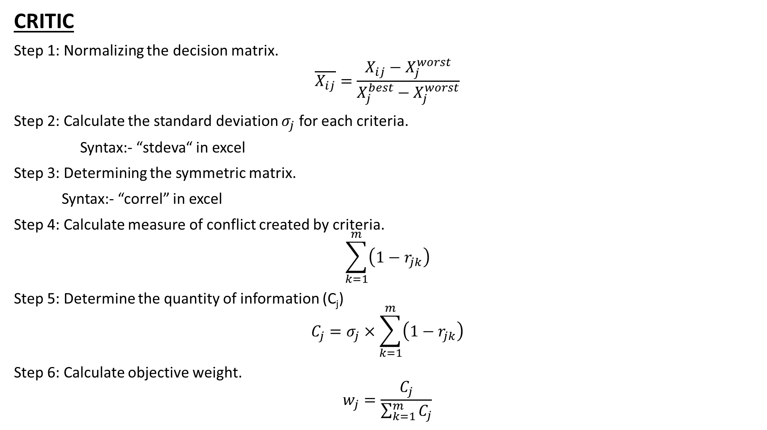
CRITIC
Step 1: Normalizing the decision matrix.
$$\overline{X_{ij}}=\frac{X_{ij}−X_{j}^{worst}}{X_{j}^{best}−X_{j}^{worst}}$$
Step 2: Calculate the standard deviation $σ_{j}$ for each criteria.
Syntax:- “stdeva“ in excel
Step 3: Determining the symmetric matrix.
Syntax:- “correl” in excel
Step 4: Calculate measure of conflict created by criteria.
$$\sum_{k=1}^{m}{\left(1−r_{jk}\right)}$$
Step 5: Determine the quantity of information (C_{j})
$$C_{j}=σ_{j}×\sum_{k=1}^{m}{\left(1−r_{jk}\right)}$$
Step 6: Calculate objective weight.
$$w_{j}=\frac{C_{j}}{\sum_{k=1}^{m}{C_{j}}}$$

Slide 15

TOPSIS
Step 1: Normalizing decision matrix.
$\overline{X_{ij}}=\frac{X_{ij}}{\sqrt{\sum_{j=i}^{n}{X_{ij}^{2}}}}$
Step 2: Weightage normalized decision matrix.
Step 3: Finding ideal best ($V_{j}^{+}$) and worst ($V_{j}^{−}$) values.
Step 4: Finding Euclidean distance from ideal best and worst.
$$S_{i}^{+}={\left[\sum_{j=1}^{m}{{\left(V_{ij}−V_{j}^{+}\right)}^{2}}\right]}^{0.5}$$
$$S_{j}^{−}={\left[\sum_{j=1}^{n}{{\left(V_{ij}−V_{j}^{−}\right)}^{2}}\right]}^{0.5}$$
Step 5: Determining Performance score ($P_{i})$ for each alternative.
$$P_{i}=\frac{S_{i}^{−}}{S_{i}^{+}+S_{i}^{−}}$$

Slide 16
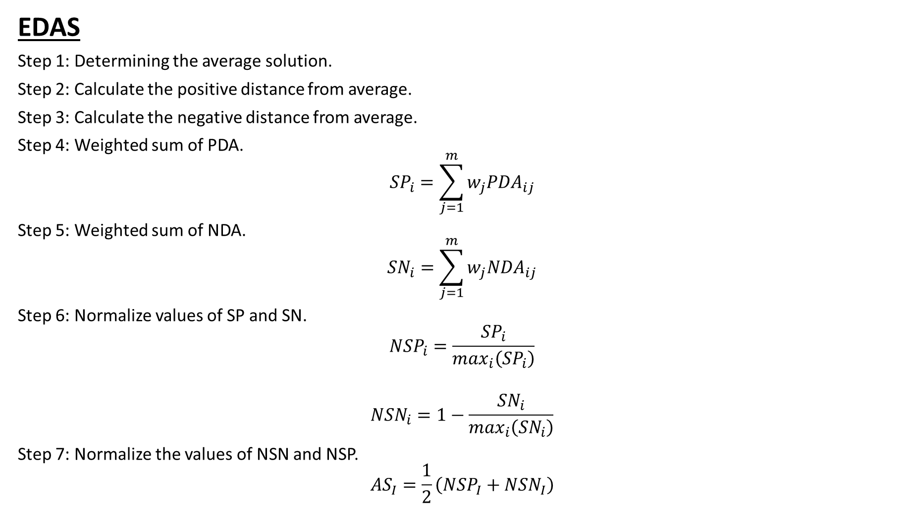
EDAS
Step 1: Determining the average solution.
Step 2: Calculate the positive distance from average.
Step 3: Calculate the negative distance from average.
Step 4: Weighted sum of PDA.
$${SP}_{i}=\sum_{j=1}^{m}{w_{j}{PDA}_{ij}}$$
Step 5: Weighted sum of NDA.
$${SN}_{i}=\sum_{j=1}^{m}{w_{j}{NDA}_{ij}}$$
Step 6: Normalize values of SP and SN.
$${NSP}_{i}=\frac{{SP}_{i}}{\max_{i}\left({SP}_{i}\right)}$$
$${NSN}_{i}=1−\frac{{SN}_{i}}{\max_{i}\left({SN}_{i}\right)}$$
Step 7: Normalize the values of NSN and NSP.
$${AS}_{I}=\frac{1}{2}\left({NSP}_{I}+{NSN}_{I}\right)$$

Slide 17

MOORA
Step 1: Normalize the decision matrix.
$$x_{ij}^{∗}=x_{ij}/{\left[\sum_{i=1}^{m}{x_{ij}^{2}}\right]}^{1/2}\left(j=1,2,…,n\right)$$
Step 2: Estimation of assessment values.
$$y_{i}=\sum_{j=1}^{g}{w_{j}x_{ij}^{∗}−}\sum_{j−g+1}^{n}{w_{j}x_{ij}^{∗}}\left(j=1,2,…,n\right)$$

Slide 18
Decision Matrix
Alternatives/ Attributes | Specific Energy (Wh/kg) | Energy Density (Wh/L) | Specific Power (W/kg) | Life Cycle | Energy Efficiency (%) | Production Cost | Working Temp (Degree Celcius) | Nominal Voltage/Cell (Volt)
LFP | 120^{[4]} | 220^{[4]} | 3250^{[4]} | 5000^{[4]} | 87.5^{[4]} | 0.335^{[4]} | 80^{[4]} | 3.2^{[4]}
NiMH | 82.5^{[2]} | 200^{[2]} | 250^{[2]} | 3000^{[2]} | 70^{[2]} | 0.335^{[2]} | 45^{[2]} | 1.2^{[2]}
LTO | 90^{[5]} | 177^{[5]} | 4000^{[5]} | 18000^{[5]} | 87.5^{[5]} | 0.665^{[5]} | 60^{[5]} | 2.4^{[5]}
LMO | 125^{[5]} | 125^{[5]} | 110^{[5]} | 750^{[5]} | 95^{[5]} | 0.665^{[5]} | 85^{[5]} | 3.9^{[5]}
LCO | 175^{[4]} | 175^{[4]} | 160^{[4]} | 500^{[4]} | 90^{[4]} | 0.335^{[4]} | 80^{[4]} | 3.7^{[4]}
Ni-Cd | 65^{[3]} | 300^{[3]} | 200^{[3]} | 2000^{[3]} | 75^{[3]} | 0.335^{[3]} | 60^{[3]} | 1.2^{[3]}
ZEBRA | 118^{[1]} | 181^{[1]} | 179^{[1]} | 3000^{[1]} | 80.9^{[1]} | 0.5^{[1]} | 350^{[1]} | 2.58^{[1]}
^{[1]} Veneri et al. (2017)
^{[2]} Ovshinsky et al. (1993)
^{[3]} Atmaja et al. (2015)
^{[4]} Sharad et al. (2022)
^{[5]} Norio et al. (2013)

Slide 19
Results and Discussion
AHP
Attributes | Specific Energy | Energy Density | Specific Power | Life Cycle | Energy Efficiency | Production Cost | Working Temp | Nominal Voltage/Cell
Specific Energy | 1 | 2 | 3 | 5 | 4 | 7 | 6 | 0.5
Energy Density | 0.5 | 1 | 2 | 4 | 3 | 6 | 5 | 0.333
Specific Power | 0.333 | 0.5 | 1 | 3 | 2 | 5 | 4 | 0.25
Life Cycle | 0.2 | 0.25 | 0.333 | 1 | 0.5 | 3 | 2 | 0.167
Energy Efficiency | 0.25 | 0.333 | 0.5 | 2 | 1 | 4 | 3 | 0.2
Production Cost | 0.143 | 0.167 | 0.2 | 0.333 | 0.25 | 1 | 0.5 | 0.111
Working Temp | 0.167 | 0.2 | 0.25 | 0.5 | 0.333 | 2 | 1 | 0.143
Nominal Voltage/Cell | 2 | 3 | 4 | 6 | 5 | 9 | 7 | 1
Sum | 4.593 | 7.45 | 11.283 | 21.833 | 16.083 | 37 | 28.5 | 2.704
Attributes | Weightage
Specific Energy | 0.227
Energy Density | 0.157
Specific Power | 0.107
Life Cycle | 0.049
Energy Efficiency | 0.073
Production Cost | 0.023
Working Temp | 0.034
Nominal Voltage/Cell | 0.327

Slide 20
AHP-TOPSIS
Alternatives | Si+ | Si- | Pi ( Relative Closeness Values) | Rank
LFP | 0.067 | 0.124 | 0.647 | 1
NiMH | 0.166 | 0.0378 | 0.185 | 7
LTO | 0.098 | 0.112 | 0.532 | 4
LMO | 0.111 | 0.130 | 0.539 | 3
LCO | 0.098 | 0.141 | 0.588 | 2
Ni-Cd | 0.170 | 0.057 | 0.251 | 6
ZEBRA | 0.122 | 0.075 | 0.381 | 5

Slide 21
AHP-EDAS
Alternatives | NSPi | NSNi
LFP | 0.608 | 1
NiMH | 0.367 | 0.786
LTO | 1 | 0.912
LMO | 0.220 | 0.754
LCO | 0.436 | 0.821
Ni-Cd | 0.428 | 0.731
ZEBRA | 0.026 | 0
Alternatives | Average | Rank
LFP | 0.804 | 2
NiMH | 0.577 | 5
LTO | 0.956 | 1
LMO | 0.487 | 6
LCO | 0.628 | 3
Ni-Cd | 0.580 | 4
ZEBRA | 0.013 | 7

Slide 22
AHP-MOORA
Alternatives | Assessment Values | Rank
LFP | 0.392 | 1
NiMH | 0.199 | 7
LTO | 0.366 | 3
LMO | 0.319 | 4
LCO | 0.367 | 2
Ni-Cd | 0.212 | 6
ZEBRA | 0.254 | 5

Slide 23
2. ENTROPY
Alternatives/ Attributes | Specific Energy | Energy Density | Specific Power | Life Cycle | Energy Efficiency | Production Cost | Working Temp | Nominal Voltage/Cell
LFP | -0.291 | -0.292 | -0.366 | -0.248 | -0.283 | -0.236 | -0.236 | -0.305
NiMH | -0.237 | -0.279 | -0.106 | -0.220 | -0.253 | -0.236 | -0.166 | -0.179
LTO | -0.249 | -0.263 | -0.349 | -0.325 | -0.283 | -0.327 | -0.198 | -0.267
LMO | -0.294 | -0.216 | -0.269 | -0.086 | -0.294 | -0.327 | -0.244 | -0.329
LCO | -0.335 | -0.261 | -0.075 | -0.063 | -0.287 | -0.236 | -0.236 | -0.323
Ni-Cd | -0.206 | -0.331 | -0.090 | -0.172 | -0.263 | -0.236 | -0.198 | -0.179
ZEBRA | -0.286 | -0.266 | -0.083 | -0.220 | -0.273 | -0.290 | -0.357 | -0.276
Summation Column wise | -1.901 | -1.911 | -1.342 | -1.338 | -1.939 | -1.891 | -1.639 | -1.861
Ej | 0.977 | 0.982 | 0.689 | 0.687 | 0.996 | 0.972 | 0.842 | 0.956
1 - Ej | 0.022 | 0.0179 | 0.310 | 0.312 | 0.003 | 0.027 | 0.157 | 0.0432
Attributes | Weightage
Specific Energy | 0.025
Energy Density | 0.020
Specific Power | 0.347
Life Cycle | 0.349
Energy Efficiency | 0.004
Production Cost | 0.031
Working Temp | 0.176
Nominal Voltage/Cell | 0.048

Slide 24
ENTROPY-TOPSIS
Alternatives | Si+ | Si- | Pi ( Relative Closeness Values ) | RANK
LFP | 0.241 | 0.257 | 0.515 | 2
NiMH | 0.370 | 0.145 | 0.282 | 3
LTO | 0.016 | 0.430 | 0.962 | 1
LMO | 0.407 | 0.121 | 0.229 | 6
LCO | 0.408 | 0.123 | 0.232 | 5
Ni-Cd | 0.386 | 0.134 | 0.258 | 4
ZEBRA | 0.397 | 0.046 | 0.105 | 7

Slide 25
ENTROPY-EDAS
Alternatives | NSPi | NSNi
LFP | 0.383 | 1
NiMH | 0.039 | 0.399
LTO | 1 | 0.868
LMO | 0.015 | 0
LCO | 0.046 | 0.119
Ni-Cd | 0.041 | 0.263
ZEBRA | 0.007 | 0.219
Alternatives | Average | Rank
LFP | 0.691 | 2
NiMH | 0.219 | 3
LTO | 0.934 | 1
LMO | 0.007 | 7
LCO | 0.083 | 6
Ni-Cd | 0.152 | 4
ZEBRA | 0.110 | 5

Slide 26
ENTROPY-MOORA
Alternatives | Average | Rank
LFP | 0.304 | 2
NiMH | 0.065 | 3
LTO | 0.581 | 1
LMO | 0.008 | 6
LCO | 0.022 | 5
Ni-Cd | 0.039 | 4
ZEBRA | -0.069 | 7

Slide 27
3. CRITIC
Attributes | Cj | Weightage
Specific Energy | 2.192 | 0.107
Energy Density | 2.512 | 0.122
Specific Power | 2.601 | 0.127
Life Cycle | 2.423 | 0.118
Energy Efficiency | 2.182 | 0.106
Production Cost | 3.723 | 0.181
Working Temp | 2.299 | 0.112
Nominal Voltage/Cell | 2.619 | 0.127
20.5564

Slide 28
CRITIC-TOPSIS
Alternatives | Si+ | Si- | Pi ( Relative Closeness Values) | RANK
LFP | 0.087 | 0.130 | 0.599 | 2
NiMH | 0.143 | 0.102 | 0.415 | 4
LTO | 0.067 | 0.167 | 0.711 | 1
LMO | 0.156 | 0.092 | 0.371 | 6
LCO | 0.145 | 0.108 | 0.427 | 3
Ni-Cd | 0.148 | 0.104 | 0.412 | 5
ZEBRA | 0.164 | 0.043 | 0.209 | 7

Slide 29
CRITIC-EDAS
Alternatives | NSPi | NSNi
LFP | 0.518 | 1
NiMH | 0.148 | 0.382
LTO | 1 | 0.784
LMO | 0.205 | 0.322
LCO | 0.293 | 0.502
Ni-Cd | 0.210 | 0.292
ZEBRA | 0.009 | 0
Alternatives | Average | Rank
LFP | 0.759 | 2
NiMH | 0.265 | 4
LTO | 0.892 | 1
LMO | 0.263 | 5
LCO | 0.398 | 3
Ni-Cd | 0.251 | 6
ZEBRA | 0.004 | 7

Slide 30
CRITIC-MOORA
Alternatives | Assessment Values | Rank
LFP | 0.227 | 2
NiMH | 0.0917 | 5
LTO | 0.249 | 1
LMO | 0.071 | 6
LCO | 0.143 | 3
Ni-Cd | 0.099 | 4
ZEBRA | 0.015 | 7

Slide 31
Rank Comparison
ALTERNATIVES/ MCDM Methods | AHP-TOPSIS | AHP-EDAS | AHP-MOORA | ENTROPY-TOPSIS | ENTROPY-EDAS | ENTROPY-MOORA | CRITIC-TOPSIS | CRITIC-EDAS | CRITIC-MOORA
LFP | 1 | 2 | 1 | 2 | 2 | 2 | 2 | 2 | 2
NiMH | 7 | 5 | 7 | 3 | 3 | 3 | 4 | 4 | 5
LTO | 4 | 1 | 3 | 1 | 1 | 1 | 1 | 1 | 1
ZEBRA | 5 | 7 | 5 | 7 | 5 | 7 | 7 | 7 | 7
LMO | 3 | 6 | 4 | 6 | 7 | 6 | 6 | 5 | 6
LCO | 2 | 3 | 2 | 5 | 6 | 5 | 3 | 3 | 3
Ni-Cd | 6 | 4 | 6 | 4 | 4 | 4 | 5 | 6 | 4

Slide 32
Comparison of Optimum results from MCDM technique, using Spearman rank correlation coefficient (r_{s})
MCDM Methods | AHP-TOPSIS | AHP-EDAS | AHP-MOORA | ENTROPY-TOPSIS | ENTROPY-EDAS | ENTROPY-MOORA | CRITIC-TOPSIS | CRITIC-EDAS | CRITIC-MOORA | AVERAGE
AHP-TOPSIS | 1 | 0.42 | 0.96 | 0.071 | -0.107 | 0.071 | 0.39 | 0.5 | 0.42 | 0.41
AHP-EDAS | 0.42 | 1 | 0.607 | 0.857 | 0.67 | 0.857 | 0.96 | 0.89 | 1 | 0.80
AHP-MOORA | 0.96 | 0.607 | 1 | 0.25 | 0.107 | 0.25 | 0.57 | 0.64 | 0.607 | 0.55
ENTROPY-TOPSIS | 0.071 | 0.857 | 0.25 | 1 | 0.89 | 1 | 0.89 | 0.821 | 0.857 | 0.73
ENTROPY-EDAS | -0.107 | 0.67 | 0.107 | 0.89 | 1 | 0.89 | 0.714 | 0.607 | 0.678 | 0.61
ENTROPY-MOORA | 0.071 | 0.857 | 0.25 | 1 | 0.89 | 1 | 0.89 | 0.821 | 0.857 | 0.74
CRITIC-TOPSIS | 0.39 | 0.96 | 0.57 | 0.89 | 0.714 | 0.89 | 1 | 0.964 | 0.964 | 0.82
CRITIC-EDAS | 0.5 | 0.89 | 0.64 | 0.821 | 0.607 | 0.821 | 0.964 | 1 | 0.892 | 0.79
CRITIC-MOORA | 0.42 | 1 | 0.607 | 0.857 | 0.678 | 0.857 | 0.964 | 0.892 | 1 | 0.81

Slide 33
CONCLUSION
Optimum selection of batteries are important for EV’s.
Selection done through MCDM techniques like TOPSIS, EDAS, MOORA and criteria weightage through AHP, CRITIC, ENTROPY methods.
AHP-MOORA, AHP-TOPSIS, ENTROPY-EDAS MCDM techniques are ignored as they have low similarity in rankings with other methods.
LTO EV battery is selected as the best from the alternatives.

Slide 34
References
Anilkumar, B. C., Maniyeri, R., & Anish, S. (2021). Optimum selection of phase change material for solar box cooker integrated with thermal energy storage unit using multi-criteria decision-making technique. Journal of Energy Storage, 40, 102807.
Lee, H. C., & Chang, C. T. (2018). Comparative analysis of MCDM methods for ranking renewable energy sources in Taiwan. Renewable and Sustainable Energy Reviews, 92, 883-896.
Emovon, I., & Oghenenyerovwho, O. S. (2020). Application of MCDM method in material selection for optimal design: A review. Results in Materials, 7, 100115.
Rathod, M. K., & Kanzaria, H. V. (2011). A methodological concept for phase change material selection based on multiple criteria decision analysis with and without fuzzy environment. Materials & Design, 32(6), 3578-3585.
Ovshinsky, S. R., Fetcenko, M. A., & Ross, J. (1993). A nickel metal hydride battery for electric vehicles. Science, 260(5105), 176-181.
Veneri, O., Capasso, C., & Patalano, S. (2017). Experimental study on the performance of a ZEBRA battery based propulsion system for urban commercial vehicles. Applied Energy, 185, 2005-2018.
Atmaja, T. D. (2015). Energy storage system using battery and ultracapacitor on mobile charging station for electric vehicle. Energy Procedia, 68, 429-437.

